Slide 1

HACKATHON-2775
This presentation will explore the prediction of term deposit subscriptions based on a dataset from a Portuguese bank.

Slide 2
INTRODUCTION TO THE DATASET
Bank Client Data
Campaign Data
The dataset includes information about bank clients, such as their age, job, marital status, education, credit default, balance, housing loan, and personal loan.
It also includes campaign data, such as the contact method used, the number of days from the last contact, and the number of contacts made.

Slide 3



Model Selection and Training
Logistic Regression
Decision Tree
We will train a logistic regression model to predict the probability of a customer subscribing to a term deposit.
We will also explore decision trees to understand the decision-making process based on the features.

Slide 4
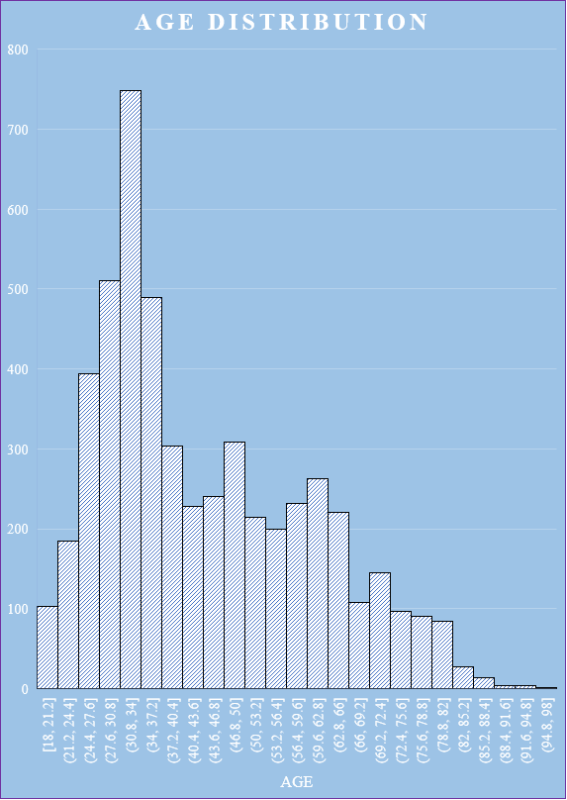
Exploratory Data Analysis
Data Visualization
Statistical Summaries
We will analyze the data to gain insights into the relationships between variables.
We will calculate descriptive statistics, such as mean, median, and standard deviation, to understand the central tendencies and spread of the data.
Identifying Patterns
We will look for patterns and correlations between variables to identify key factors influencing subscriptions.

Slide 5
Data Preprocessing
Handling Missing Values
Data Transformation
We will address missing values using techniques like imputation or removal.
We will transform variables as needed, such as converting categorical variables into numerical ones.

Slide 6

Feature Engineering
Creating New Features
Feature Selection
We will create new features based on existing ones, such as combining variables or calculating ratios.
We will select the most relevant features for model training, using techniques like feature importance or statistical analysis.

Slide 7
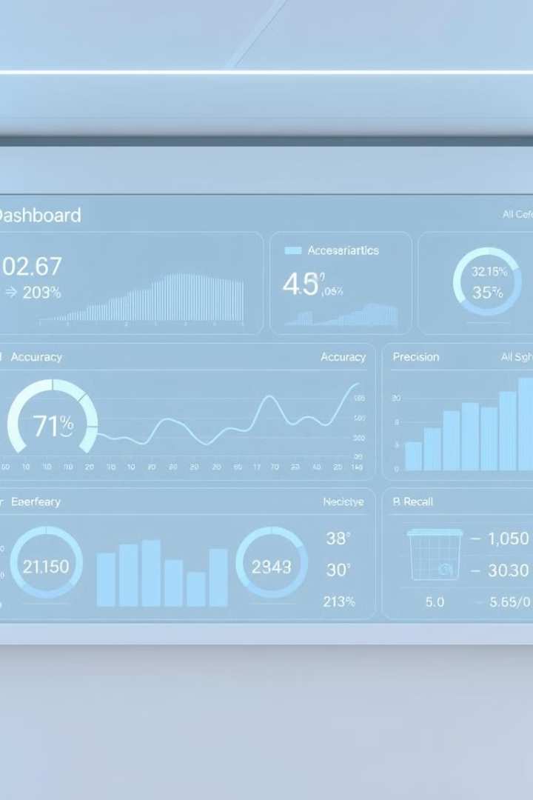
Model Evaluation and Comparison
We will evaluate the performance of the models using metrics like accuracy, precision, recall, and F1-score.
1
We will compare the performance of the different models to identify the best model for predicting term deposit subscriptions.
2
63.42%
F1 Score
64.37%
Precision
64.27%
Accuracy
Balanced measure of
precision
and recall
Measuring the proportion of correctly predicted positive cases.
Measuring the overall
correctness of the model’s prediction

Slide 8



Insights and Recommendations
Key Factors
1
We will identify the key factors that influence term deposit subscriptions based on the model results.
Targeted Marketing
2
We will recommend targeted marketing strategies based on the insights gained from the model.
Business Impact
3
We will analyze the potential impact of these recommendations on the bank's business.

Slide 9
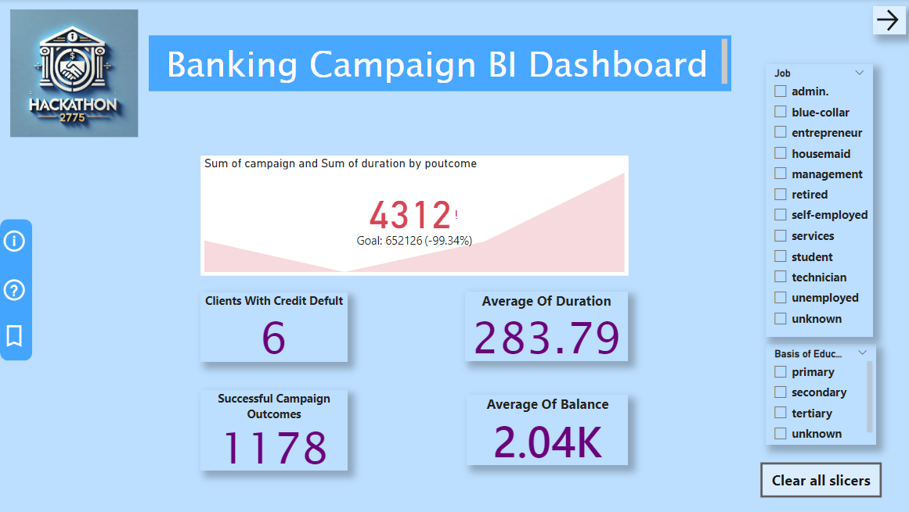

Slide 10
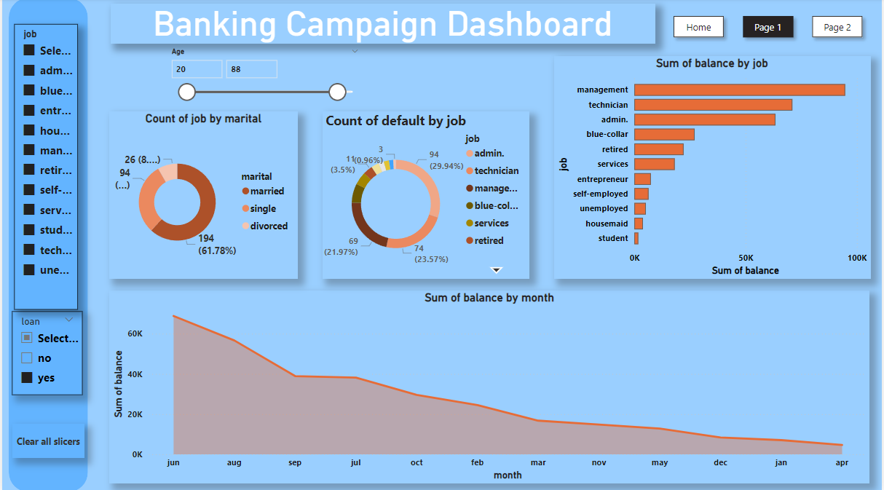

Slide 11
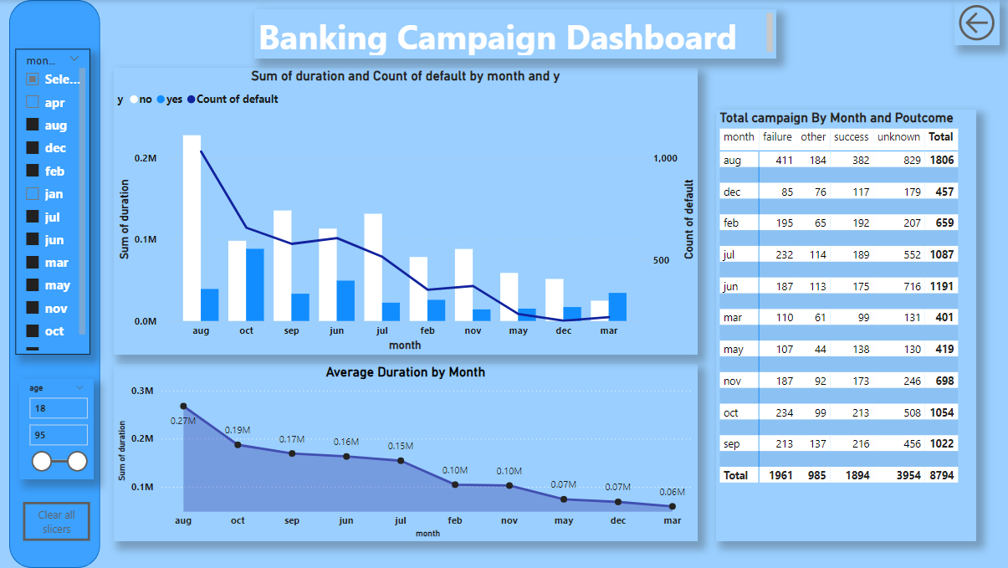

Slide 12
Conclusion and Next Steps
Model Deployment
1
We will deploy the best performing model for real-time prediction of term deposit subscriptions.
Continuous Monitoring
2
We will monitor the model's performance over time and make necessary adjustments to ensure accuracy.
Further Exploration
3
We will continue exploring new data sources and techniques to further improve the model's predictive power.
https://github.com/tanmay506/Hackathon-Key-Code-2775.git

Slide 13
THANK YOU

